Slide 1
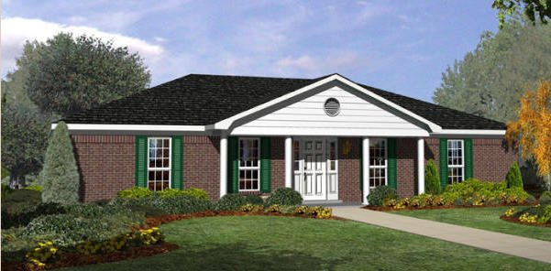
Jacqueline Majumder and city of mobile
2645 Greenback Drive

